Slide 1
An introduction to openstudio and energyplus
Edward Vuong

Slide 2
Who am I?
What I do
Road cycling
Whole building optimization
Codes development (Retrofit & carbon code)
Gas Heat pump
Modelling tool development
What NRC’s Construction Research Centre does
Building envelope material development/testing
Building acoustics (transmission prediction, signal processing, perception assessment)
Indoor air quality (airborne transmission, arctic HRV/ERV application)
Climate resiliency adaptation (overheating, resiliency, future looking climate data)

Slide 3

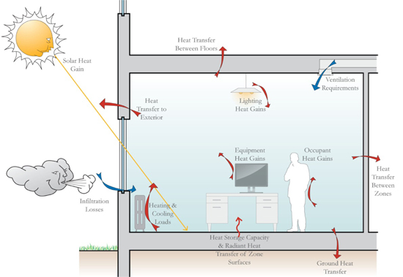

The Goal of this Workshop
By the end, participants should be able to:
Model using OpenStudio
Ask questions
Figure 1. Energy transfers in a building (Payette, 2018)

Slide 4
Overview
What is BEM?
SketchUp our building (exercise)
OpenStudio – Envelope (exercise)
OpenStudio – Internal loads (exercise)
HVAC Overview
OpenStudio – HVAC (exercise)
Energy Conservation Measures
OpenStudio Parametric Analysis Tool (exercise)

Slide 5
Building energy modelling (BEM)
Characterize energy and moisture
Between the building and the external environment
Within the building
For example…
Power generation
Battery charging
People
“everything”
Figure 1. Energy transfers in a building (Payette, 2018)

Slide 6
When to….
Skip BEM
USE BEM
Measurement and verification
Alterations/Retrofit
Heuristics
Utility bills
Garbage input (garbage output)
Uncertain input
Simpler alternative
Code compliance
Explain or justify
Physical phenomenon (academic)
What happens to X when Y occurs? (professional)
Forecast/predict hypotheticals (academic + professional)
Exploratory
Calibration

Slide 7
BEM Tools: EnergyPlus & OpenStudio
E+ is a building energy simulation program
Detail physics
Funded by the US DOE: 1997- present
Open-source
“No user interface” → intended as an engine
DesignBuilder, Autodesk Revit, Trace3D Plus
OpenStudio Project
US DOE: 2008 – present; open-source
Several pieces of software and tools
OpenStudio Application – “OpenStudio”
OpenStudio SketchUp plug-in
Parametric Analysis Tool
OpenStudio SDK, OpenStudio-Standards, OpenStudio Server
The rest of “car”

Slide 8
BEM Tools: EnergyPlus & OpenStudio
OpenStudio Project (cont.)
Contributions from
US Labs (ORNL, LBNL, NREL, PNNL, ANL)
Private organizations (OpenStudio-Coalition)
Industry & academia (Autodesk, Carrier, Trane, individual firms, professionals/academics)
“Canadian content” (NRCan, NRC)
Continuous development, reliable, free, community
Limited tech support
IES, Trace3D, DesignBuilder
SketchUp
3D CAD
Architectural/interior design
Plug-ins

Slide 9
General procedures for modelling buildings
Building information need:
Geometry
Construction details
Air leakage
Internal loads
Schedule and setpoints
HVAC
Components, HVAC drawings (zoning)
Domestic hot water

Slide 10
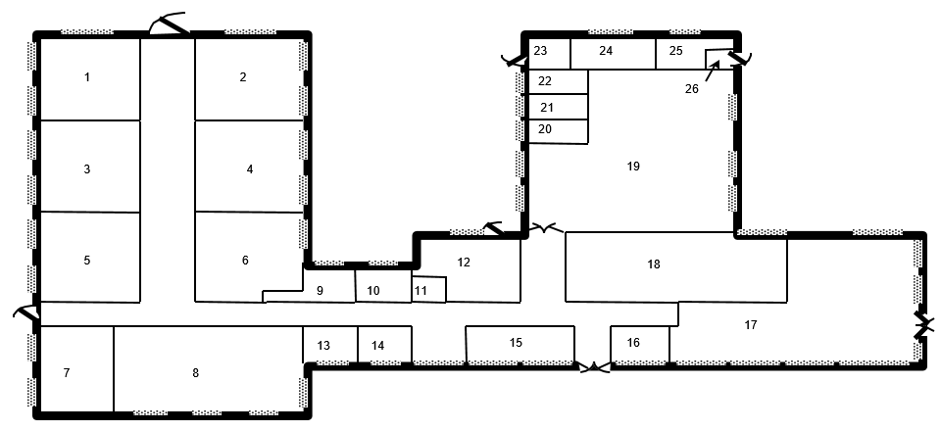
Zoning (thermal zones)
Volume of air with a single average temperature
The building we’re in right now
Approximate as a box with air
Avoid temperature variations
Entire building – too coarse
Rule of thumbs
Similar activity/occupancy, HVAC, orientation/location (windows)
No single right answer
Figure 2. Ft. Monmouth floor plan (GARD Analytics and University of Illinois, 2003)

Slide 11
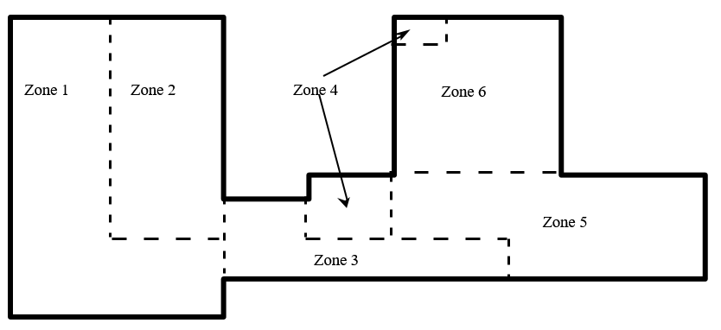
Zoning (thermal zones)
Figure 3. Ft. Monmouth floor plan zoned (GARD Analytics and University of Illinois, 2003)

Slide 12
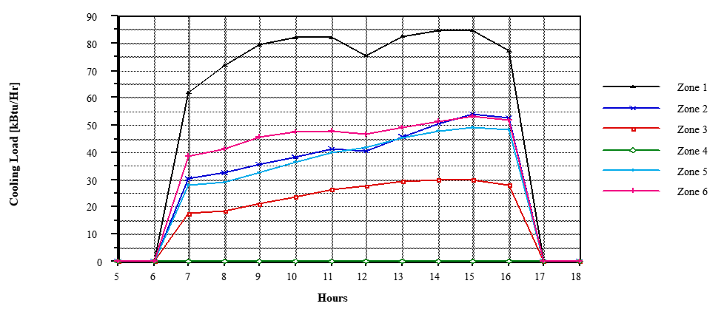
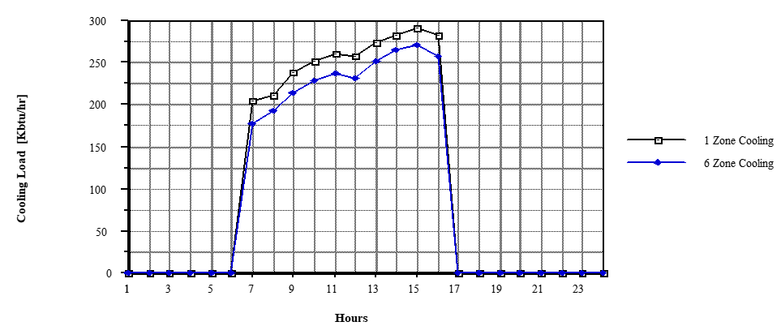
Zoning (thermal zones)
Figure 4a. Ft. Monmouth zone cooling load and Figure 4b Ft. Monmouth 1 & 6 zone cooling load (GARD Analytics and University of Illinois, 2003)
Differences: Cooling load < 10%, Heating load < 1%
Is this acceptable?

Slide 13
Simulation Parameters
Timestep
Discrete time intervals
“Usually” 10 - 15 min
Shadow calculation
Shadows cast by building, shading devices
OS default: 20 day average (daylighting modelling – more frequent)
Ground temperature
Gradual change
Can be significant for residential; less for commercial
Autosizing
Eqp capacity, flowrate, load, fan power
Sizing factor
Sequential & uniform loading
Design day
ASHRAE design day conditions

Slide 14
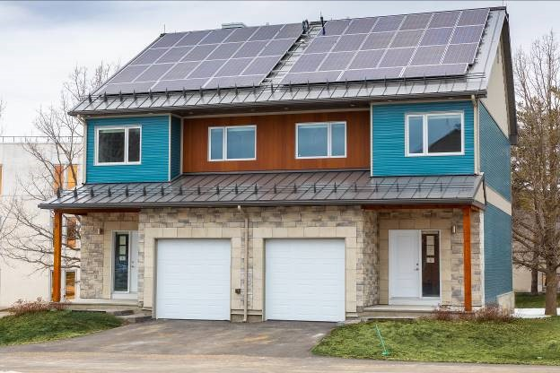
Exercise: Let’s sketchup our building
Create a model
Canadian Centre for Housing Technology research facility
NZER
Semi-detached
150 m²
Side by side comparison
CCHT-F is the test facility (left)
500 sensors (incl. assembly)
Gas, electricity, water
OS_exercise>sketchup>CCHT_plans “CCHT-F” plans
3_sketchup_exercise.pdf
4 zones
Figure 5. CCHT E and F

Slide 15
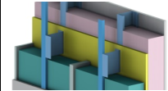
building envelope
Envelope – walls, roofs, floor, fenestration (doors, windows, skylights)
Construction – assembly of layers of materials that form the envelope
Thermal bridge (thermal bypass) – areas of an construction that allows heat to easily flow through
Studs, balconies, window perimeters
Derates insulation (R-value)
E.g. 77% insulation & 23% stud vs 100% insulation
Extensive guide from Morrison Hershfield
Figure 6. Wall cross section (Morrison-Hershfield, 2018)

Slide 16
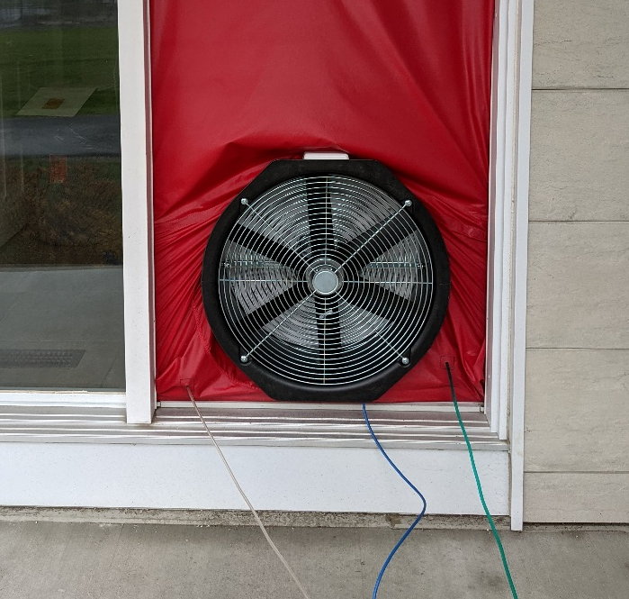
Air Leakage
Unintended outdoor air leaking into (infiltration) or out of (exfiltration) the building
Blower door test
Closed up vs as-operated
Figure 7. Blower door test fan

Slide 17
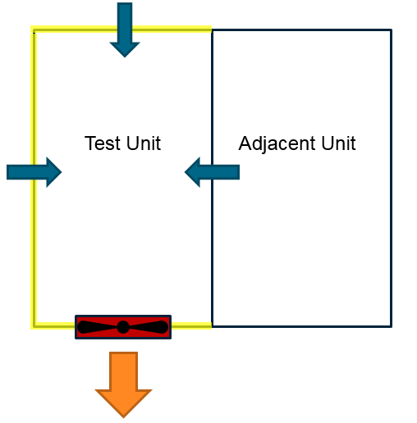
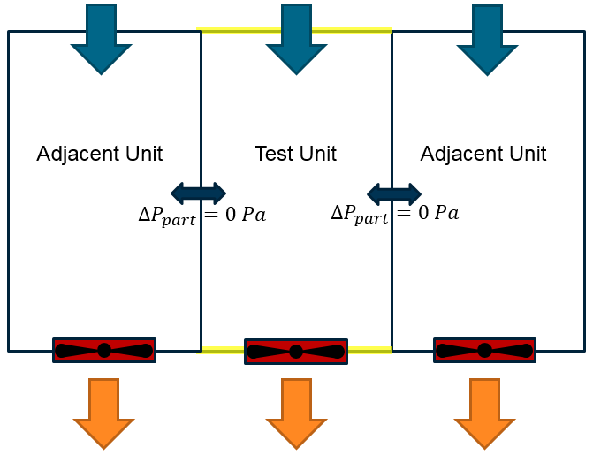
Air Leakage
Blower door test cont.
Guarded vs unguarded
Negative, positive, single/multi-point (pressure)
ACH50, Flow coefficient, Effective leakage area (4Pa or 10Pa), flow per exterior area (75Pa)
Figure 8. Unguarded blower door test
Figure 8. Guarded blower door test

Slide 18

Exercise: Air leakage modelling
Characterizing the air leakage rate
$$Q=C {\left(∆P\right)}^{n}$$
$Q−flowrate in \frac{L}{s∙m^{2}}$
$C−flow coefficient in \frac{L}{s{ m}^{2}{Pa}^{n}};building specific$
$∆P−pressure differtial in Pa$
$n−pressure coefficient (\sim 0.67 for most buildings)$
Converting leakage rates from one pressure to another (4._os_envelope_exercise.pdf)
$$Q_{4 Pa}=Q_{50 Pa} \frac{C_{4} {\left(4\right)}^{n} }{C_{50} {\left(50\right)}^{n}}$$

Slide 19
Openstudio exercise: envelope
Insulated surfaces
Blu_wall: R-28 (U-value 0.198 W/m²∙K)
Ground_floor: R-18 (U-value 0.319 W/m²∙K)
Attic floor/second storey ceiling - R-53 (U-value 0.106 W/m²∙K)
Uninsulated surfaces
Roof
Interior surfaces
doors
Adiabatic partitions
Window
U-value 0.83 W/m²∙K

Slide 20
Internal Loads in OpenStudio
Sources of heat that warms up a building
Light
Occupants
Plug (receptacle) and process loads
Different “types of heat” in modelling
Lighting
Convected, visible (short wave), long wave, return air
Max power
entered in internal gains object
Occupants
Sensible, latent, radiant
Activity level (W per person)
Entered as a schedule
Plug or process
Convected, radiant, loss (e.g. exhausted)
Don’t use the nameplate value (nominal power)
Exceptions: electric resistive, constant load

Slide 21
Sources for internal gain data
Lighting
ASHRAE Fundamental
EnergyPlus Input Output Reference document (Table 1.28) (from ASHRAE 1282 RP)
ASHRAE Fundamental 2021: Chapter 18 – Table 3 for lighting heat gain
Occupancy
ASHRAE Fundamental 2021: Chapter 18 – Table 1
https://www.cambeep.eng.cam.ac.uk/system/files/documents/internalheat.pdf
Plug/process loads
ASHRAE Fundamental 2021 - Chapter 18 - Table 4A to Table 11
http://hes-documentation.lbl.gov/calculation-methodology/calculation-of-energy-consumption/heating-and-cooling-calculation/internal-gains
NBC 2020 – Table 9.36.5.4 for Residential Buildings
NBC 2020 and NECB 2020
Code compliance modelling default

Slide 22
Schedules in Openstudio
Control equipment and events
Control logic (1 for on, 0 for off)
Temperature setpoints
Number of occupants
Occupant activity level
Temperature, power, fractions, dimensionless

Slide 23
OpenStudio Exercise: Internal Loads
OS_exercise > openstudio-gains
5_os_internal_gains_exercise.pdf
internal_gains_schedule_data.xlsx
Heat gain fractions
Occupant activity
Schedule fractions
internal_gain_reference_tables.pdf
Data tables from ASHRAE Fundamentals and EnergyPlus I/O doc

Slide 24
An Overview of HVAC systems and equipment
Purpose: condition and ventilate a space
Types of HVAC: Centralized and Decentralized
Centralized
Boiler + pump + baseboards/radiators
Chillers + pumps + water coils
Decentralized
Window air conditioners
Electric baseboards
Packaged, Split, Unitary
Interchangeable?

Slide 25
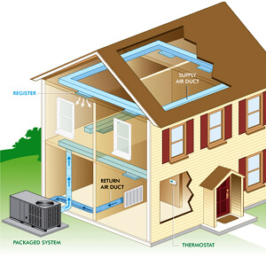
An Overview of HVAC systems and equipment
Unitary - An HVAC system comprised of one or more factory built assemblies
Packaged – a single package
Figure 9. Packaged system (Petro Home Services, 2023)

Slide 26
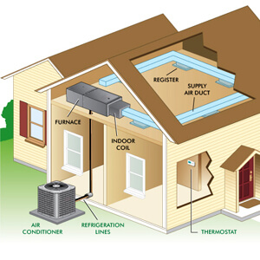
An Overview of HVAC systems and equipment
Split system
More than one assembly
Indoor separated from outdoor
Multi-split
Ducted
Figure 10. Split system (Petro Home Services, 2023)

Slide 27
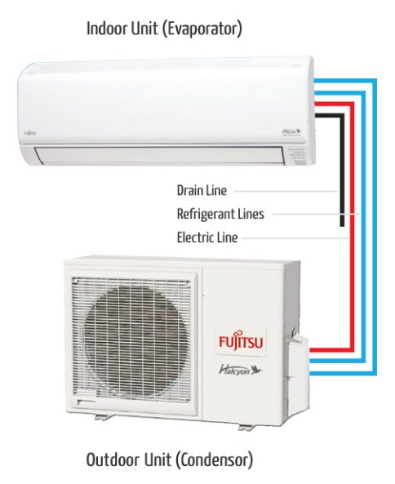
An Overview of HVAC systems and equipment
Split cont.
Ductless
Figure 11. Mini-split (Fujitsu General , 2023)

Slide 28
OpensTudio HVAC
Air and water based
Conditioning air/water and circulating it
Sometimes brine instead of water
Fundamental/component level view
Heating
Electric coil, gas coil, direct expansion coil, water coil
Cooling
Cooling tower, chiller, direct expansion coil, water coil

Slide 29
Ventilation: HRV & ERV
Introduce outdoor air
Exhaust stale indoor air
Opportunity to save energy by preheat/cooling
Heat recovery ventilator (HRV)
Energy recovery ventilator (ERV)

Slide 30
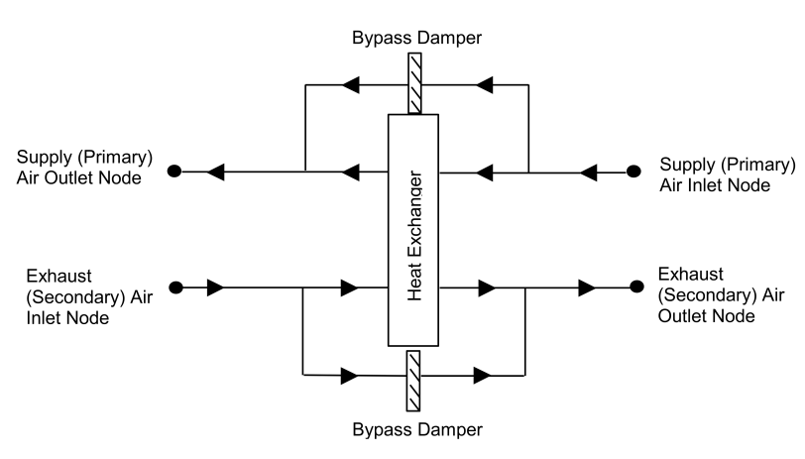
Ventilation: HRV
Thermal energy only → heat
Leakage (cross contamination)
Figure 12. ERV schematic (U.S. Department of Energy, 2021)

Slide 31
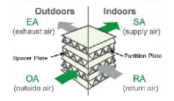
Ventilation: ERV
Heat and moisture → energy exchange
ERV core
Cross flow
Moisture wicking material
Enthalpy wheel
Rotating wheel
Same type of material as a core
Inside view
Cross contamination
Figure 13. ERV core (Mitsubishi Electric Sales Canada, 2021)

Slide 32

Examples of HVAC systems
Central air conditioner (AC) and furnace
Common
Single package or separate equipment
Cold climate air source heat pump
No formal definition
Rated capacity $≥$ 3.52 kW @ -8.3 ºC
70% of the -8.3 ºC rated capacity @ -15 ºC
COP $≥$ 1.8 @ -15 ºC

Slide 33
Openstudio exercise: HVAC + DHW
Constant volume central AC + NG furnace
Air conditioner: COP 3
Condensing furnace: AFUE 96%
Rotary ERV (~ 50% effectiveness
Only first and second floor conditioned
Single thermostat
Heating: 21 ºC; Cooling: 24 ºC
Domestic hot water
Demand
Peak flow demand: 0.000083 ~ 300 L/hr
OS_exercises > openstudio-hvac
dhw_load_profile.osm
Electric water heater
UA-factor: 1.3 W/K
100 % efficiency
Located in first_storey
2 hour recovery (for sizing)
Pump head 300 Pa
Misc.
Air leakage test results:
Whole building ELA = 134 cm²
Assume cracks/gaps uniformly distributed based on volume
Zone | Volume (m³) | ELA (cm²)
Attic | 259.01 | 51
First_storey | 199.14 | 40
Second_storey | 217.92 | 43

Slide 34
Things to be mindful of
NZER → low EUI
ERV defrost model limited (no degradation due to ice)
Ground temperature 18ºC
Difficult to capture
Kiva model
HVAC control is basic
EnergyPlus EMS
Rigid loop structure
Limited features in OpenStudio App
Work-a-rounds

Slide 35
Openstudio (EnergyPlus) Results
EnergyPlus output files
DesignBuilder results viewer (free)
EnergyPlus Reports
Summary tables
LEED summary

Slide 36
BEM and Standards/Guidelines
ASHRAE Standard 140
“Pseudo-standard” for BEM
ASHARE Guideline 14 (calibration)
Procedure and standard for estimating energy, water and demand savings
Normalized mean bias error (NME)– 10%
Coefficient of variation of the root-mean-square error (CV-RSME)– 30%
Ruleset schema and checker – ASHRAE P229
Common ruleset model report (RMR) schema
Ruleset checking tool (RCT)

Slide 37
OpenStudio references and help
EnergyPlus Documentation
EnergyPlus web-based documentation
Official Quickstart
Lecture ppt
Kiva ground heat transfer model
OpenStudio Documentation
OpenStudio App + SketchUp for OS
YouTube
OpenStudio + SketchUp
NREL
OpenStudio SDK
OpenStudio Support
Unmet Hours
Energy Models
EnergyPlus Support
Official EnergyPlus Support

Slide 38
Energy Conservation Measures (ECM)
aka Energy efficiency measures (EEM)
Strategies for saving energy
Upgrade
New system
Repair?
Examples
Windows & insulation
Better boiler/water heater/fans
Window-wall ratio
Leakage control
Better control/automation

Slide 39
Applying ECM in Openstudio
Changing insulation
Increase material thickness
Swap material
New construction
Changing the window-wall ratio
Delete/add new window (redraw)
OpenStudio Measures
De-risk, synergize, scale
More data, consistency, productivity, shareable
Commands delete/add/swap/alter a model → single package
Go through an example

Slide 40
OpenStudio measures
Ruby script
Instructions that control programs
Interpreted vs compiled (program)
Ruby is an interpreted language e.g. python, matlab, javascript
Sources for OpenStudio measures
Measure writers are not omnipotent
Example: multiple measures
Example: create prototype
Measure walkthrough & OpenStudio-Standards

Slide 41
Parametric Study
Multiple ECMs and inputs → combinations
Small scale parametric study
Improve CCHT F’s envelope
A few ECMs
South WWR (0.35, 0.45, 0.55, 0.65)
Wall R-value (R-20, R-40, R-60)
OpenStudio App
12 simulations in series
12 files in parallel
Parametric Analysis Tool
1 file
12 alternatives
Example
Case # | WWR | Wall R-value
case_1 | 0.35 | R-20
case_2 | 0.35 | R-40
case_3 | 0.35 | R-60
case_4 | 0.45 | R-20
case_5 | 0.45 | R-40
case_6 | 0.45 | R-60
case_7 | 0.55 | R-20
case_8 | 0.55 | R-40
case_9 | 0.55 | R-60
case_10 | 0.65 | R-20
case_11 | 0.65 | R-40
case_12 | 0.65 | R-60

Slide 42
Parametric Analysis Tool
Large(r) scale analyses
More than a few ECMs
Investigating the performance of a system (as a measure)
Vary building
Vary location
Retrofit portfolio of buildings
Building type, location
Automated optimization
Full factorial experiment
Particle swarm
Genetic algorithm

Slide 43
References
Fujitsu General . (2023). What is a Mini-Split? Retrieved from Fujitsu General United States & Canada: https://www.fujitsugeneral.com/us/residenGARD Analytics, & University of Illinois. (n.d.). Lecture 07 Building Modeling Questions.
EnergyPlus University Course Teaching Material. Retrieved from https://energyplus.net/assets/nrel_custom/eplus_files/university_course.zip.
Fujitsu General . (2023). What is a Mini-Split? Retrieved from Fujitsu General United States & Canada: https://www.fujitsugeneral.com/us/residential/what-is-a-mini-split.html
Mitsubishi Electric Sales Canada. (2021). How it works: Energy Recovery Ventilator Cores. Markham: Mitsubishi Electric Sales Canada. Retrieved from https://www.mitsubishitechinfo.ca/sites/default/files/010_HiW%20Energy%20Recovery%20Cores.pdf
Morrison Hershfield. (2018). Morrison-Hershfield. Retrieved from https://www.bchydro.com/content/dam/BCHydro/customer-portal/documents/power-smart/builders-developers/building-envelope-thermal-bridging-guide-v1-6.pdf
Payette. (2018, November 7). Energy modeling and the whole building approach to energy efficiency. Energy Modeling and the Whole Building Approach to Energy Efficiency. Retrieved February 19, 2023, from https://www.payette.com/news/energy-modeling-and-the-whole-building-approach-to-energy-efficiency/
Petro Home Services. (2023). HVAC Packaged Unit vs. Split System: Differences, benefits, and how to choose. Retrieved from Petro Home Services: https://www.petro.com/resource-center/hvac-packaged-unit-vs-split-system
Tec tube. (2017, September 26). Fundamentals of Energy Recovery Ventilators (ERVs) [Video]. US: Youtube. Retrieved from https://www.youtube.com/watch?v=QOSelUK6dpQ&t=100s
U.S. Department of Energy. (2021). EnergyPlus Version 9.6.0 Documentation: Input Output Reference. NREL.

